Slide 1
PROFIT ANALYSIS
TEAM –
KAJAL POKLE
BHAGYASHRI DEVKAR
PUJA TALEKAR
AJAY WADILE

Slide 2
TABLE OF CONTENTS
01
02
03
04
FETCH DATABASE
REGRESSION ANALYSIS
PREDICTED ANALYSIS
POWER BI DASHBORAD
05
INSIGHTS & SUGGESTIONS

Slide 3
01
FETCH DATABASE
Task 1 - Get data from the database with the given credentials.

Slide 4
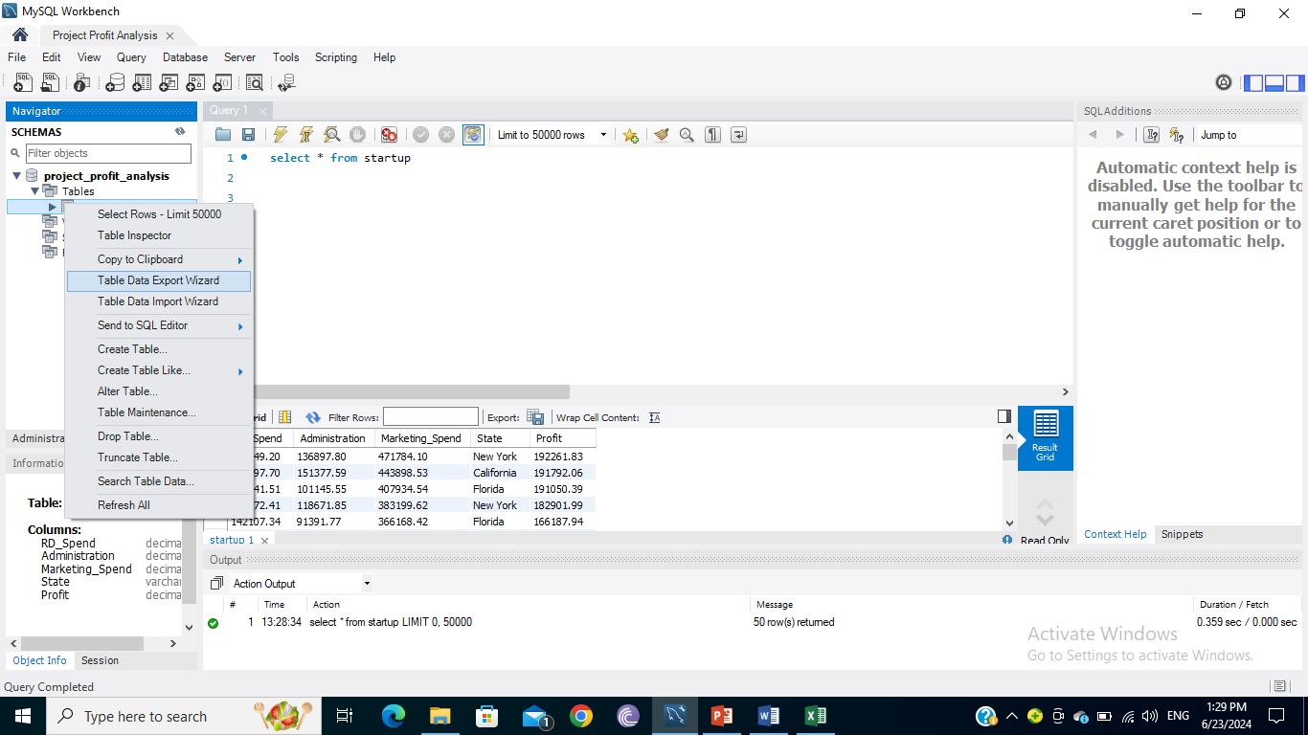
As per the task dataset fetched from MySQL database & process for the same shown here.

Slide 5
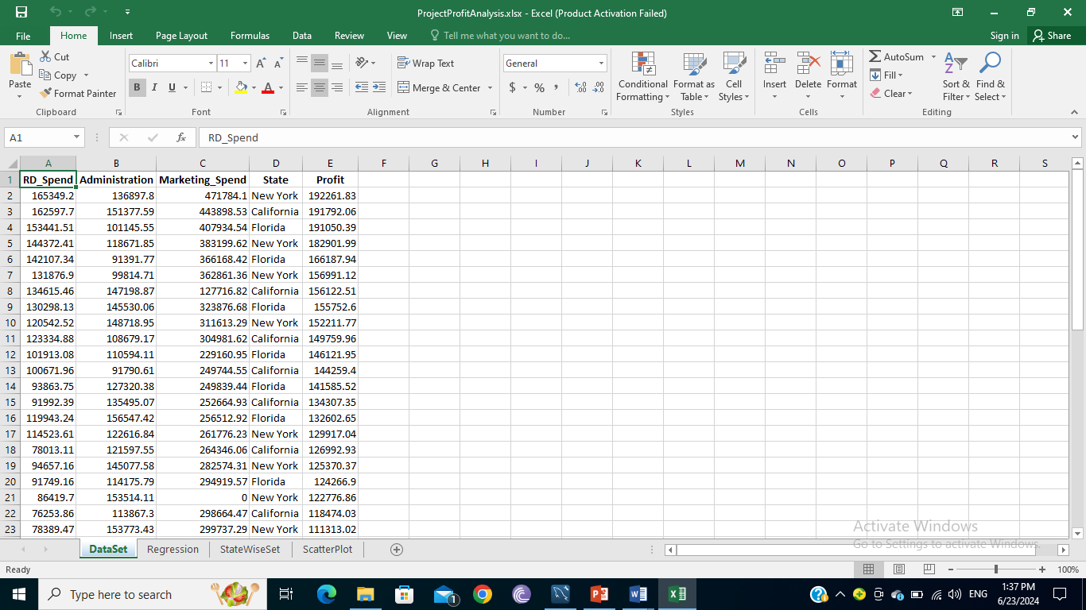
Here is the Dataset of Profit Analysis Project which we got from database.

Slide 6
02
REGRESSION ANALYSIS
Task 2 - Perform Regression Analysis for the given data to identify how the money spent on Marketing, R&D, and Administration is affecting the company’s Profit.

Slide 7
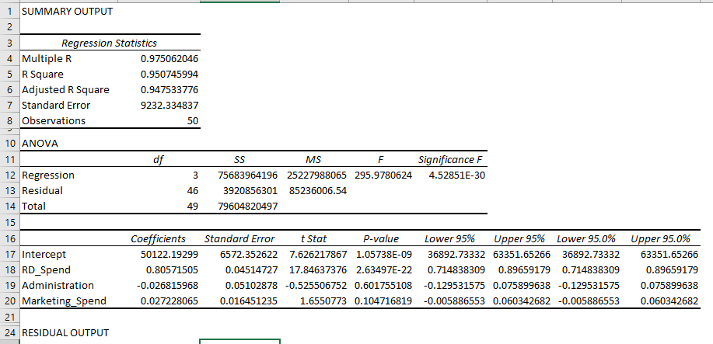

Slide 8
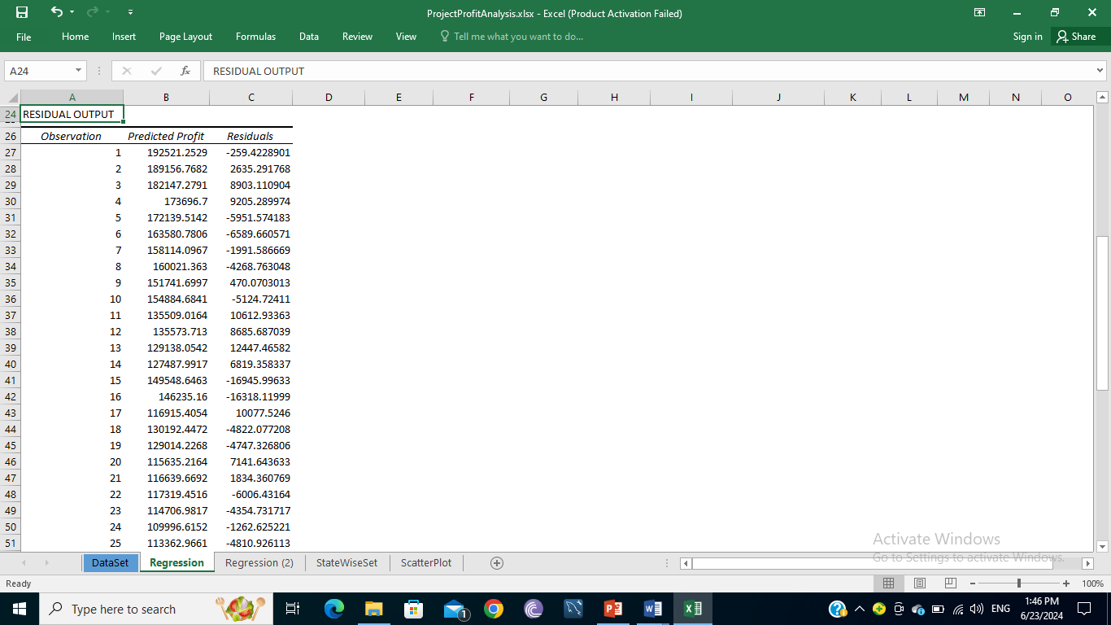
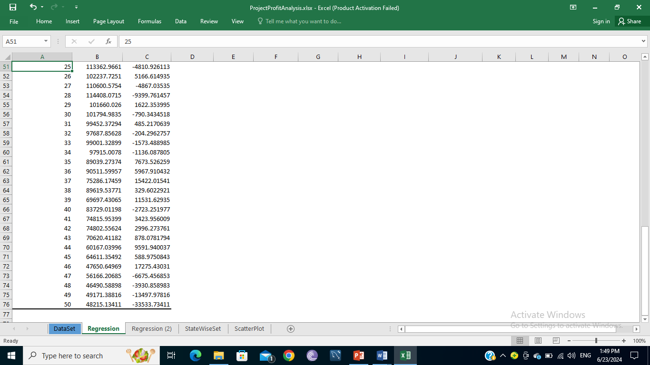

Slide 9
03
PREDICTED ANALYSIS
Task 3 - Predict the Profit for the below-given input features.

Slide 10
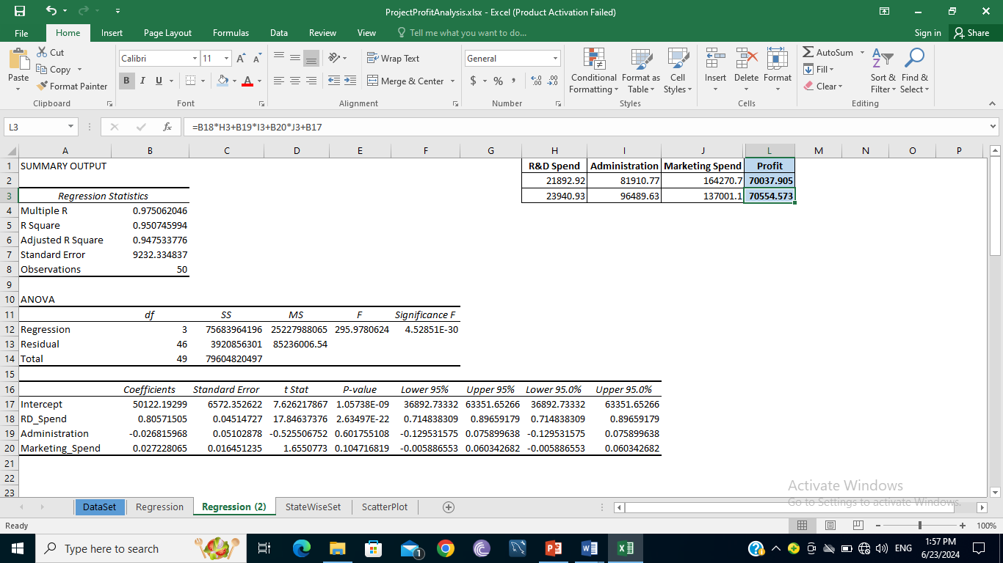
R&D Spend | Administration | Marketing Spend | Profit
21892.92 | 81910.77 | 164270.7
23940.93 | 96489.63 | 137001.1
Here is the output for the predicated profit using the regression analysis method-

Slide 11
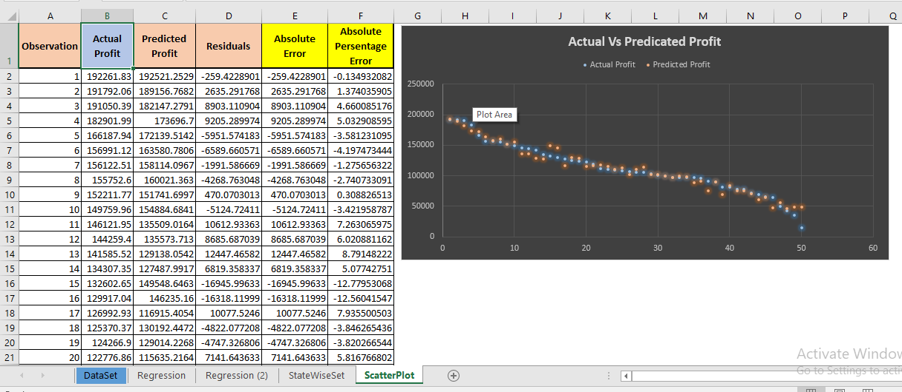
In Below image we can see the Actual Profit vs the Predicated Profit with Scatter Plot -

Slide 12
04
VISUALIZATION
Task 4 - Visualize the data using Power BI.

Slide 13
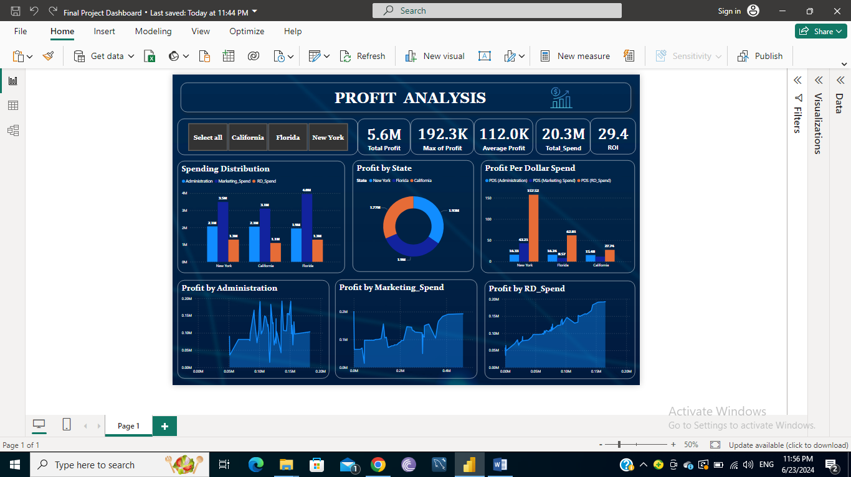

Slide 14
05
INSIGHTS & SUGGESTIONS
Task 5 - insights about all the features provided and give your inputs/suggestions to the company.

Slide 15
Insights -
Total spend (i.e.20.3M) of all department is higher than the Profit of all department (5.6M).
Profit vs. R&D Spending - A positive correlation would suggest higher R&D spending tends to increase profit.
Profit vs. Administration Spending – no clear pattern is observed & administration spending may not be a significant driver of profit.
Profit vs. Marketing Spending - A positive trend would indicate effective marketing strategies leading to higher profits.
Spending by Location –
Marketing Spend is the highest in overall all state i.e. in New York 3.5, California 3.1 & Florida 4.
RD Spend is the lowest in overall all state i.e. in New York 1.3, California 1.1 & Florida 1.3.
Positive Growth - RD department had given positive growth/profit in upward way.

Slide 16
Recommendations to company -
Optimize R&D Investment - Encourage higher investment in R&D, as it shows a strong positive correlation with profit.
Evaluate Marketing Strategies - Assess the effectiveness of marketing campaigns to ensure they are generating sufficient returns.
Efficiency in Administration - While necessary, consider optimizing administrative costs to improve overall profitability.
Regional Strategy –
Explore differences between states to tailor strategies accordingly. This could involve understanding local market dynamics and consumer behaviors.
With a significantly higher ROI of 33%, New York's strategies should be closely examined to identify best practices that can be replicated or adapted in other locations to enhance overall profitability.

Slide 17
Thank You

